Slide 1
GROUP/COMPANY NAME
Student name and numbers:

Slide 2
The need and the problem you need to solve

Slide 3
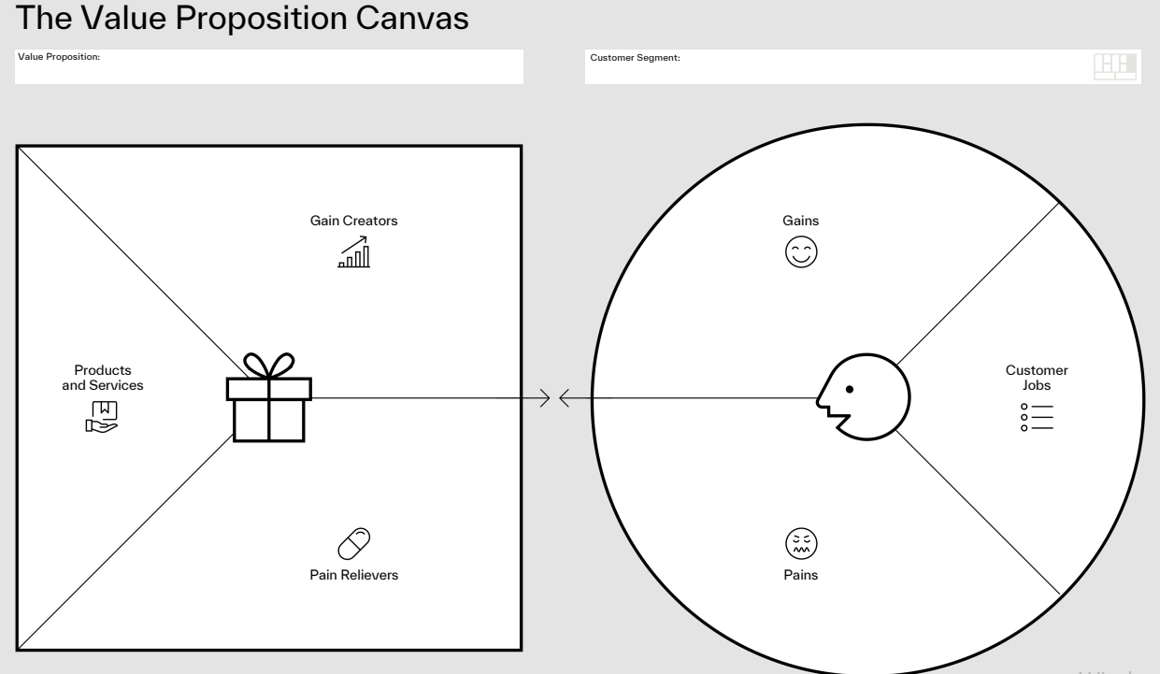

Slide 4
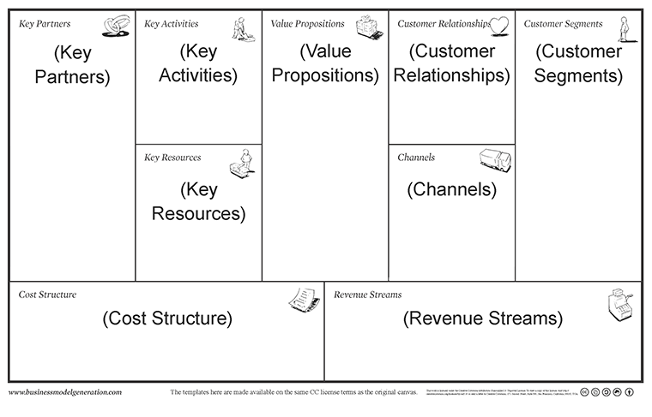
BUSINESS CANVAS
The Business Model Canvas (BMC) gives you the structure of a business plan without the overhead and the improvisation of a ‘back of the napkin’ sketch without the fuzziness (and coffee rings).

Slide 5
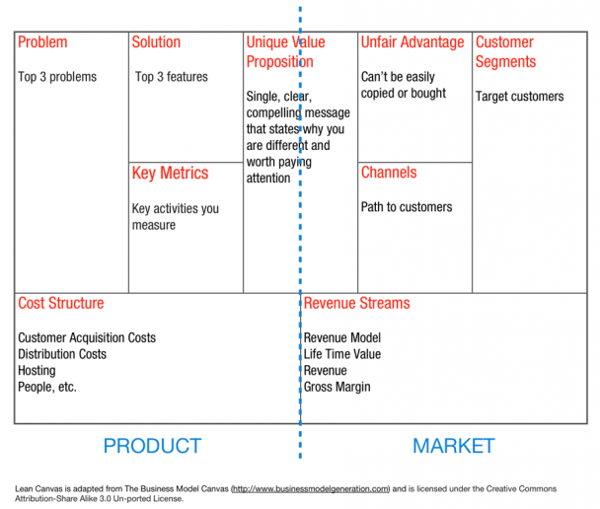
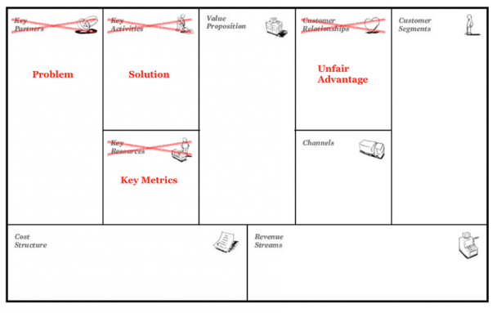
Lean Canvas
http://leanstack.com/why-lean-canvas/

Slide 6
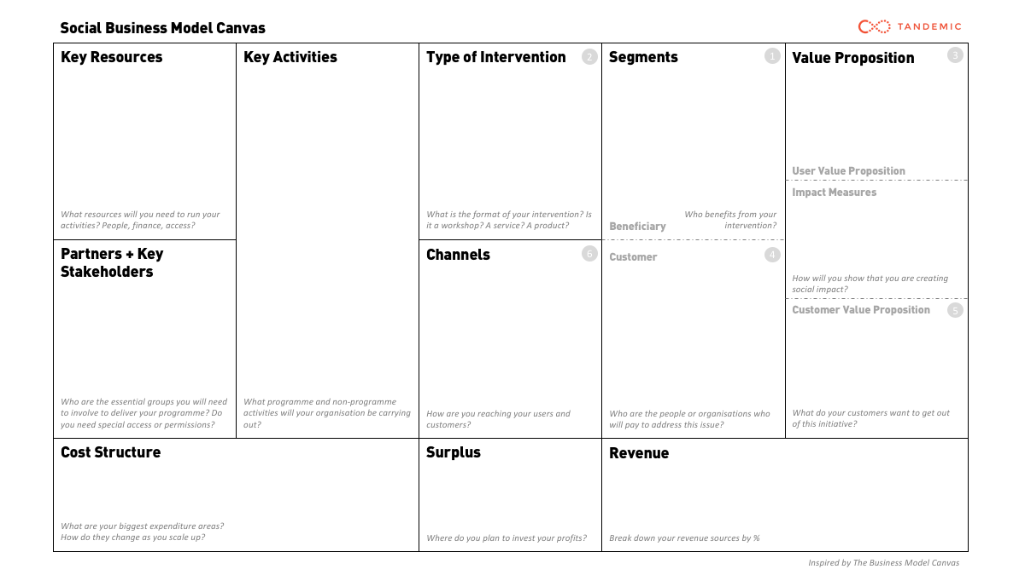
Social Business Model Canvas
https://www.socialbusinessmodelcanvas.com/

Slide 7
BENCHMARK
 | YOUR COMPANY | COMPETITOR 1 | COMPETITOR 2 | COMPETITOR 3
feature 1
feature 2
feature 3
feature 4
feature 5
feature 6

